Slide 1
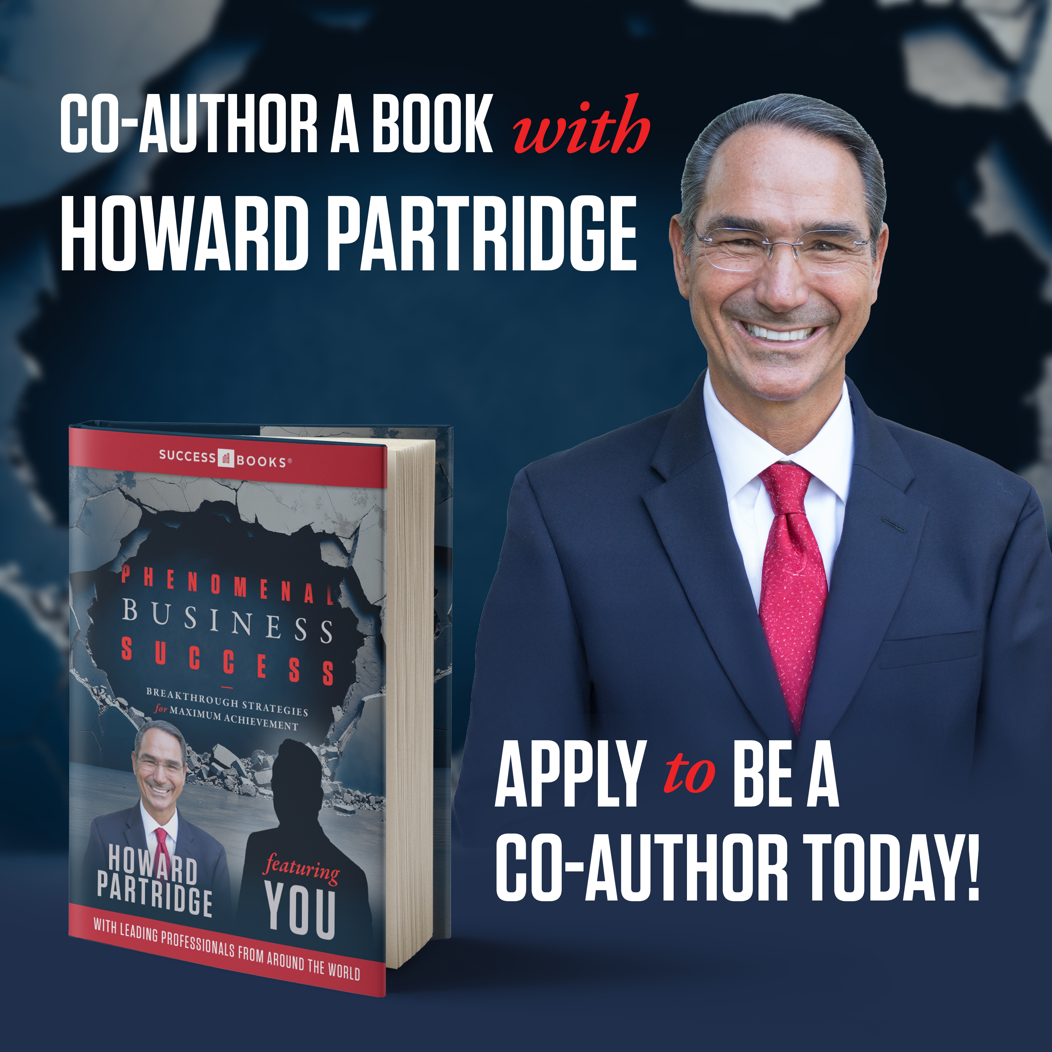

Slide 2
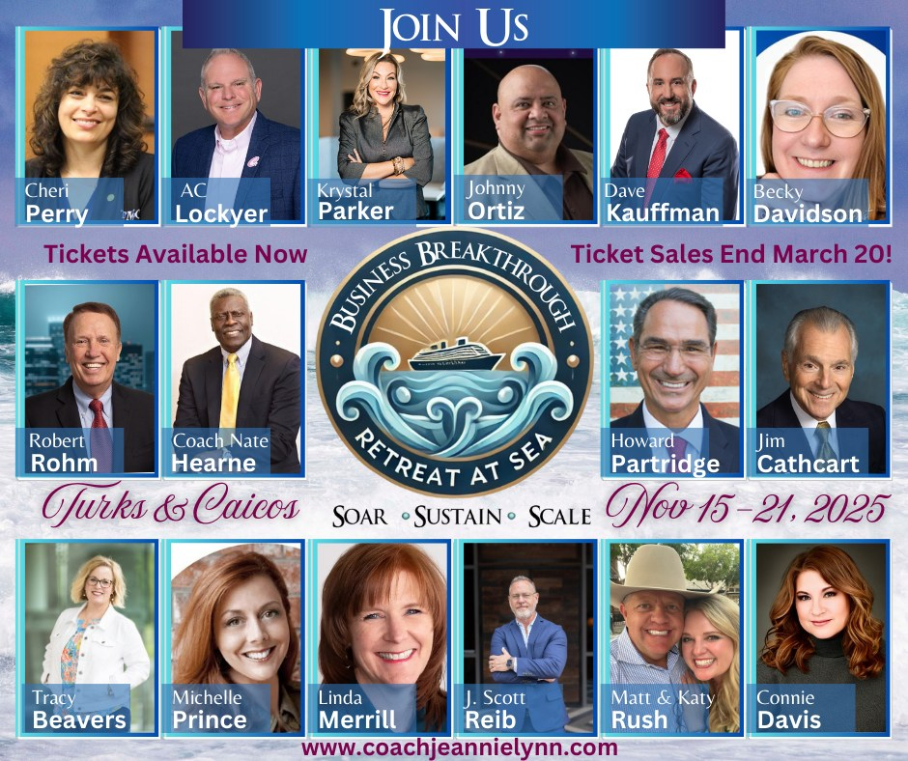
Win a FREE CRUISE!

Slide 3
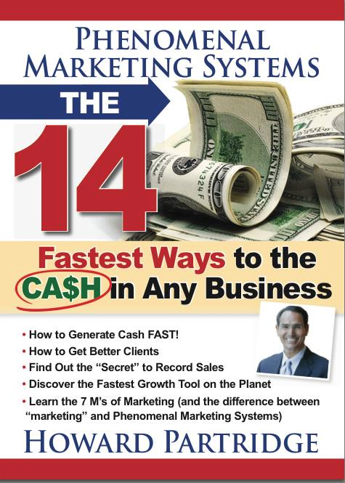

Slide 4
Phenomenal Marketing Systems
Marketing is everything you do to attract prospects to your business.
Phenomenal Marketing delivers a meaningful experience that engages, educates, and entertains.
A Phenomenal Marketing System is a group of working parts that duplicates results consistently.

Slide 5
The 7 M’s of Phenomenal Marketing
Your Phenomenal Mindset
Your Phenomenal Money
Your Phenomenal Mission
Your Phenomenal Market
Your Phenomenal Message
Your Phenomenal Methods
Your Phenomenal M.A.P.

Slide 6
Where You Need a Phenomenal Message…
E-mails!
Brochures
Speaking
Networking
Power Words “verbal ads”
Newsletter articles
Mailers, greeting Cards
Sales scripts
Publicity
Any advertising you do

Slide 7
P.S.R.
Problem
Solution
Results

Slide 8
My 7 Step Process
Build Rapport
Connect Emotionally
Establish Credibility
Identify Problem
Outline Solution
Share Investment
Overcome Objections

Slide 10
3 Vital Components of Phenomenal Marketing Copy
A Bold Headline.
Emotional Body Copy
A Call To Action

Slide 11
A Bold HEADLINE/Subject Line
80% of the your message
Should appeal to your prospect
Benefit driven
Emotional
Targeted to only your audience
77

Slide 12
Sample Headlines
“Avoid Uneducated, Uninformed, and Sometimes Downright Unscrupulous
<Your Service Type>!”
“STOP Being a SLAVE to Your Business!”

Slide 13
Other Proven Headlines
How To… Select a Professional….
Testimonial Headlines – pull the best line “Increased My Sales 157%””
5 Reasons You’ll Love Our Service…
Get FREE CASH or FREE SERVICE through Our Referral Reward Program!
Did You Get Your Free Money?

Slide 14
2. Emotional Body COPY
Lots of copy is okay – the more you tell the more you sell
Engaging – use words like “you”
Emotional – not technical
Benefits – “you get”
Build the experience “5 Point Marketing Message”

Slide 15
The Only 2 Reasons People Buy Stuff…
1.They Have to 2.They Want to.
1.Fear of Pain 2.Hope of Gain.
1.To Avoid Pain 2.To Get Gain.

Slide 16
The 4 Great MOTIVATORS from Direct Mail Copy that Sells
Fear (of loss)
(usually better than potential for gain)
Exclusivity
Guilt
Greed

Slide 17
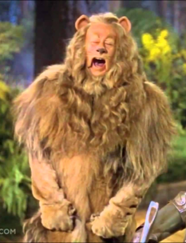
Fear: of What?
Not being treated right (or worse)
Wrong information
Being stood up
Not getting what was paid for
Not getting a good job
Not getting the best
Not reaching their goals

Slide 18
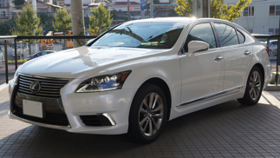
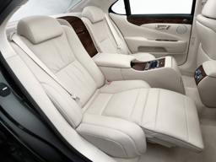
Exclusivity
The Lexus “Experience”
The Starbucks “Experience”
The Ritz Carlton “Experience”
People want to feel “SPECIAL”
The “Status” Symbol
Exclusive Membership

Slide 19
Guilt
Haven’t taken care of their investment
Leaving their family “exposed”
Haven’t done right by their team

Slide 20
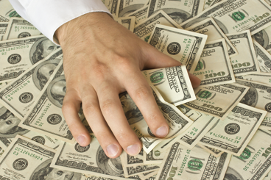
Greed
FREE
Savings
Special Offer
Free Trial Offer
Free Food, Free Money, Free Service!

Slide 21
5 POINT “EXPERIENTIAL” MARKETING MESSAGE
Reputation
Experience
Education
Systems
Guarantee
Notes:
5 POINT SALES PRESENTATION

Slide 22
The 5 Point Marketing Message Satisfies All 4 of Lewis’ Motivators
The Fear Factor: If Fear is the Motivator, Trust is the “Satisfier”. If I have gotten the most trustworthy company with no risk (guarantee), then I have “satisfied” the fear.
The Exclusivity Factor: If I work with a company that has the best reputation, experience, and education, I am working with the “best” which “satisfies” my need for exclusivity.
The Guilt Factor: If I get the best company, I am “satisfied” that I have done good by my family and my investments.
The Greed Factor: If I have gotten the absolute best with no risk, I have “satisfied” my need to get as much value as I possibly can.

Slide 23
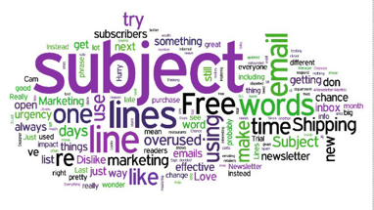
“The 13 Most Powerful” Words in Advertising
Discover
Easy
Guarantee
Health
Love
Money
New
Proven
Results
Safety
Save
You
FREE

Slide 24
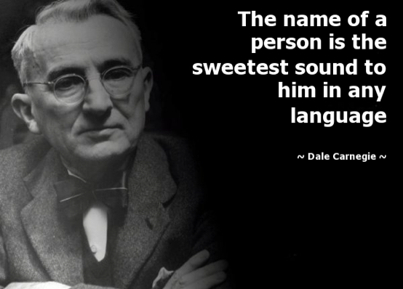

Slide 25
TESTIMONIALS/Reviews
Creates social proof
Get permission to use it
Use as a Headline
Use in body copy
Give your testimonial a headline
Make sure they are TRUE!
Use a disclaimer
82

Slide 26
Your CALL TO ACTION
Tell them exactly what to do…
Call, E-mail, click, REPLY, Fill out this form, come talk to me now, etc.
Using the word “today” makes a big difference.
Example Call 281-634-0404 Today!

Slide 27
Create a Sense of Urgency
Lewis’ 4 Great Motivators
The WHY…
Special Offer with Expiration
79

Slide 28
3 Marketing Books to Read
79

Slide 29
Short Cut
Open AI: ChatGPT

Slide 30
How to Become a Phenomenal Presenter
Deliver Your Message with Confidence
Notes:
Chris Parrish, POA, MP, Welcome

Slide 31
Why This is Important…
“If you can’t communicate and talk to other people and get across your ideas, you’re giving up your potential”
- Warren Buffet
Notes:
Warren Buffet Quote.

Slide 32
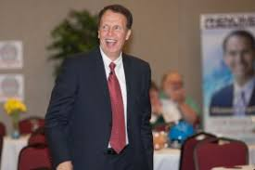

Slide 38
Save the Dates! July 23-25

Slide 39
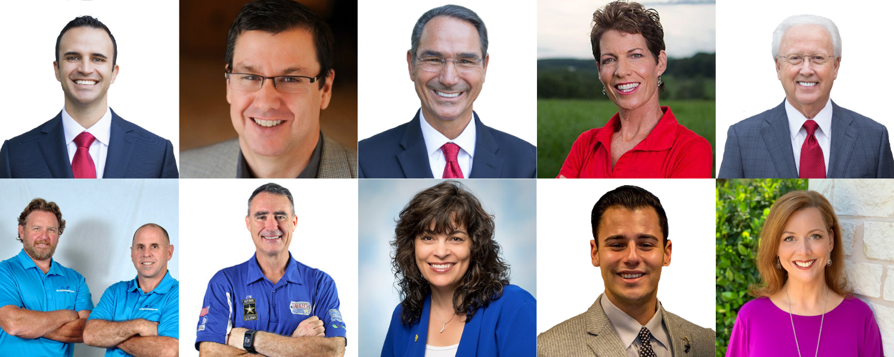
Inner Circle Coaching

